Slide 1

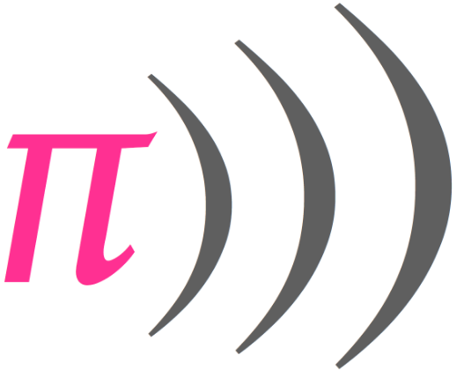
Basics Of Sonic Pi

Slide 2
Learning Objectives
Writing a note
Playing a note
Repeating a note
MIDI notes and numbers
Sonic-Pi cheat sheet

Slide 3

Getting Started With Writing And Playing A Note
Select buffer 0 ( ) located at the bottom-left corner of the programming panel.
Type 60 and select run from the upper left corner. If you hear a beep, then everything is working alright.
  Try to play different numbers that are between 0 and 127.
Sonic Pi is familiar with both MIDI note numbers (values between 0 and 127) and traditional musical notation (such as :C4, :Eb3 or :G5). The number you have just used are called MIDI notes.
  MIDI is a useful way to:
    Compose your notes.
    Test your notes.
    Adjusting the notes by lowering their value (making your note lower) or increasing it, (making the pitch higher).

Slide 4
Playing A Melody
Click on buffer and type play 60, play 61, play 62 each on its line and click run. You will realize that Sonic Pi plays all of them at once. That is not a melody but a way of writing chords. For the Sonic Pi to play them in a sequence (each note at a time), type sleep 1 before every line as below:
Play 60
Sleep 1
Play 61
Sleep 1
Play 62
Sleep 1
and so on
Sleep 1 tells Sonic Pi to wait for one beat. You can try smaller and bigger numbers. The smaller the sleep value, the shorter the duration is between the play commands and vice versa.
Play plays a beeps. Lower numbers make lower pitched beeps and higher numbers make higher pitched beeps

Slide 5
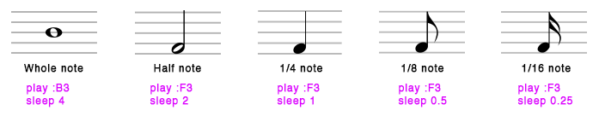
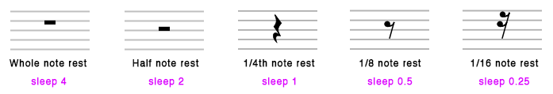
Notes in Sonic Pi
Below is a musical notation representation to show you what different notes look in Sonic Pi
Note: This notes can be written as MIDI (numbers between 0 and 127). So, there is no need to worry if you are not familiar with the notes shown in the images above.
In the following slide, a chart displaying notes and their corresponding MIDI values is shown.

Slide 6
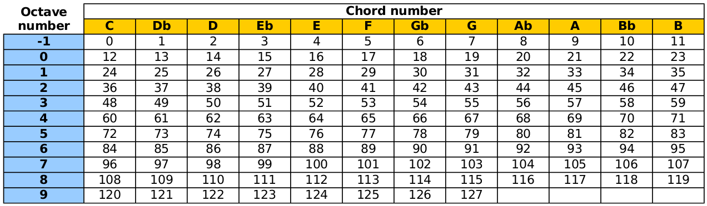
Notes in Sonic Pi
The diagram shows notes and their corresponding MIDI in sonic pi
Music Notes to MIDI Note Values simplified
Middle C
Middle D
Middle E
Middle F
Middle G
Middle A
Middle B
=
=
=
=
=
=
=
60
62
64
65
67
69
71
=
=
=
=
=
=
=
C4
D4
E4
F4
B4
A4
B4

Slide 7
Try It Yourself
Use notes from the middle C scale (60, 62, 64, 65, 67, 69, 71). Remember to add sleep time so as to play your beats in sequence.
  Play the MIDI by hitting the run.
Repeat the above using MIDI corresponding notes i.e. (C4, D4, E4, F4, B4, A4, B4).
  Play the notes and hear if they have the same melody as above.
Note: You can use use_bpm in the beginning to make your tune faster or slower. The acronym BPM stands for Beats Per Minute. For example:
  use_bpm 120
  play 60
  sleep 0.25
  play 62
  sleep 0.25
  play 64
and so on

Slide 8
Repeating A Melody
A melody or piece of a melody can be played a couple times without having to duplicate your notes. This is called iteration which means repetition/do things more than once.
  To do this, the command times do is added at the beginning of your code and to break from the loop, the command end is added at the end of the code e.g. 2 times do then your code. This will iterate the code specified 2 times. You can use any value depending on how many times the notes need to be repeated.
  This command (times do) can be inserted inside another to repeat just a section of your code.
  See the examples below:

Slide 9
Repeating A Melody
Repeating A Melody
Example 1
2.times do
play :c4
sleep 0.5
play :d4
sleep 0.5
play :e4
sleep 0.5
play :c4
sleep 0.5
end
Example 2
4.times do
4.times do
play :c4
sleep 0.25
end
play :d4
sleep 0.5
play :f4
sleep 0.5
end
Note that example 2 has a loop inside of another. There are 2 4.times do; the second is the second loop

Slide 10
Sources and References
http://sonic-pi.mehackit.org/exercises/en/01-introduction/01-introduction.html
http://sonic-pi.net/

